Slide 1
PEP CLASSES DBMS lect1

Slide 2
Difference between FLAT FILE AND DBMS
A file system is a software that manages and organizes the files in a storage medium, whereas DBMS is a software application that is used for accessing, creating, and managing databases.
The file system doesn’t have a crash recovery mechanism on the other hand, DBMS provides a crash recovery mechanism.
Data inconsistency is higher in the file system. On the contrary Data inconsistency is low in a database management system.
File system does not provide support for complicated transactions, while in the DBMS system, it is easy to implement complicated transactions using SQL.
File system does not offer concurrency, whereas DBMS provides a concurrency facility.

Slide 3
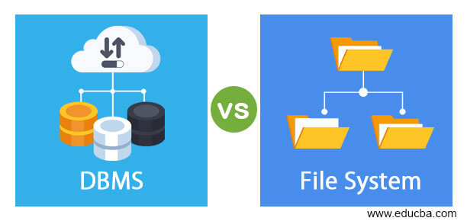

Slide 4
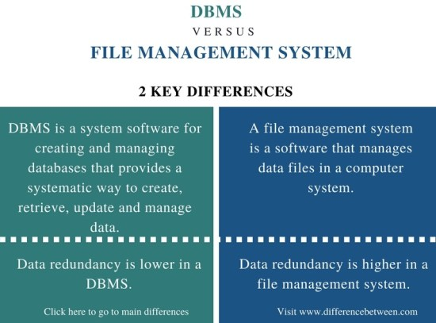

Slide 5
Features of a File system
It helps you to store data in a group of files.
Files data are dependent on each other.
C/C++ and COBOL languages were used to design the files.
Shared File System Support
Fast File System Recovery.

Slide 6
Features of DBMS
A user-accessible catalog of data
Transaction support
Concurrency control with Recovery services
Authorization services
The value of data is the same at all places.
Offers support for data communication
Independent utility services
Allows multiple users to share a file at the same time

Slide 7
Advantages of File system
Enforcement of development and maintenance standards.
Helps you to reduce redundancy
Avoid inconsistency across file maintenance to get the integrity of data independence.
Firm theoretical foundation (for the relational model).
It is more efficient and cost less than a DBMS in certain situations.
The design of file processing is simpler than designing Database.

Slide 8
Advantages of DBMS system
DBMS offers a variety of techniques to store & retrieve data
Uniform administration procedures for data
Application programmers never exposed to details of data representation and Storage.
A DBMS uses various powerful functions to store and retrieve data efficiently.
Offers Data Integrity and Security
The DBMS implies integrity constraints to get a high level of protection against prohibited access to data.
Reduced Application Development Time
Consume lesser space
Reduction of redundancy.
Data independence.

Slide 9
Application of File system
Here, are an important application of the file system:
Language-specific run-time libraries
API programs using it to make requests of the file system
It is used for data transfer and positioning.
Helps you to update the metadata
Managing directories.

Slide 10
Application of the DBMS system
Admission System Examination System Library System
Payroll & Personnel Management System
Accounting System Hotel Reservation System Airline Reservation System
It is used in the Banking system for Customer information, account activités, Payments, déposits, loans, etc.
Use for Airlines for reservations and schedules
DBMS system also used by universities to keep call records, monthly bills, maintaining balances, etc.
Finance for storing information about stock, sales, and purchases of financial instruments like stocks and bonds.

Slide 11
Disadvantages of File system
Each application has its data file so, the same data may have to be recorded and stored many times.
Data dependence in the file processing system are data-dependent, but, the problem is incompatible with file format.
Limited data sharing.
The problem with security.
Time-consuming.
It allows you to maintain the record of the big firm having a large number of items.
Required lots of labor work to do.

Slide 12
Disadvantages of the DBMS system
Cost of Hardware and Software of a DBMS is quite high, which increases the budget of your organization.
Most database management systems are often complex systems, so the training for users to use the DBMS is required.
The use of the same program at a time by many users sometimes lead to the loss of some data.
DBMS can’t perform sophisticated calculations
Data-sets begins to grow large as it provides a more predictable query response time.
It required a processor with the high speed of data processing.
The database can fail because or power failure or the whole system stops.
The cost of DBMS is depended on the environment, function, or recurrent annual maintenance cost.

Slide 13
MCQ
What is a database? a) Organized collection of information that cannot be accessed, updated, and managed b) Collection of data or information without organizing c) Organized collection of data or information that can be accessed, updated, and managed d) Organized collection of data that cannot be updated

Slide 14
Which one of the following refers to the copies of the same data (or information) occupying the memory space at multiple places.
Data Repository
Data Inconsistency
Data Mining
Data Redundancy

Slide 15
Which one of the following refers to the "data about data"?
Directory
Sub Data
Warehouse
Meta Data

Slide 16
Which of the following refers to the level of data abstraction that describes exactly how the data actually stored?
Conceptual Level
Physical Level
File Level
Logical Level

Slide 17
The term "Data" refers to:
The electronic representation of the information( or data)
Basic information
Row Facts and figures
Both A and C

Slide 18
Which type of data can be stored in the database? a) Image oriented data
b) Text, files containing data
c) Data in the form of audio or video
d) All of the above

Slide 19
In which of the following formats data is stored in the database management system? a) Image
b) Text
c) Table
d) Graph

Slide 20
Which of the following is not a type of database? a) Hierarchical
b) Network
c) Distributed
d) Decentralized

Slide 21
Which of the following is not an example of DBMS? a) MySQL
b) Microsoft Acess
c) IBM DB2
d) Google

Slide 22
Which of the following is a feature of DBMS? a) Minimum Duplication and Redundancy of Data b) High Level of Security
c) Single-user Access only
d) Support ACID Property

Slide 23
Which of the following is not a function of the database? a) Managing stored data b) Manipulating data c) Security for stored data d) Analysing code

Slide 24
Which of the following is a function of the DBMS? a) Storing data b) Providing multi-users access control c) Data Integrity d) All of the above

Slide 25
Which of the following is a component of the DBMS? a) Data b) Data Languages c) Data Manager d) All of the above

Slide 26
What does an RDBMS consist of? a) Collection of Records b) Collection of Keys c) Collection of Tables d) Collection of Fields

Slide 27
_____________ is a hardware component that is most important for the operation of a database management system. a) Microphone b) High speed, large capacity disk to store data c) High-resolution video display d) Printer

Slide 28
interface between ________________ and ________________ of an enterprise-class system. a) Data and the DBMS b) Application and SQL c) Database application and the database d) The user and the software

Slide 29
The traditional storage of data organized by the customer, stored in separate folders in filing cabinets is an example of ______________ type of ‘database’ management system. a) Object-oriented database management system b) Relational database management system c) Network database management system d) Hierarchical database management system

Slide 30
Which of the following is not the utility of DBMS? i) Backup ii) Loading iii) Process Organization iv) File organization a) i, ii, and iv only b) i, ii and iii only c) i, iii and iv only d) All i, ii, iii, and iv

Slide 31
Which of the following is correct regarding the file produced by a spreadsheet? a) can be used as it is by the DBMS b) stored on disk in an ASCII text format c) all of the mentioned d) none of the mentioned

Slide 32
The oldest DB model is _______________ a) Network b) Physical c) Hierarchical d) Relational

Slide 33
What happens if a piece of data is stored in two places in the db? a) Storage space is wasted & Changing the data in one spot will cause data inconsistency b) In can be more easily accessed c) Changing the data in one spot will cause data inconsistency d) Storage space is wasted

Slide 34
Which of the following commands is used to save any transaction permanently into the database?
Commit
Rollback
Savepoint
None of the above

Slide 35
The term "Data independence" refers to____
Data is defined separately and not included in the programs
Programs are not dependent on the logical attributes of the data
Programs are not dependent on the physical attributes of the data
Both B & C

Slide 36
Data integrity constraints are used to: a) Control who is allowed access to the data b) Ensure that duplicate records are not entered into the table c) Improve the quality of data entered for a specific property d) Prevent users from changing the values stored in the table

Slide 37
______ is a special type of integrity constraint that relates two relations & maintains consistency across the relations. a) Entity Integrity Constraints b) Referential Integrity Constraints c) Domain Integrity Constraints d) Domain Constraints

Slide 38
Which one of the following uniquely identifies the elements in the relation? a) Secondary Key b) Primary key c) Foreign key d) Composite key

Slide 39
Foreign key is the one in which the ________ of one relation is referenced in another relation.
Foreign keyB. Primary keyC. ReferencesD. Check constraint

Slide 40
Which one of the following attribute can be taken as a primary key? a) Name b) Street c) Id d) Department

Slide 41
Which one of the following cannot be taken as a primary key? a) Id
b) Register number
c) Dept_id
d) Street

Slide 42
The relation with the attribute which is the primary key is referenced in another relation. The relation which has the attribute as a primary key is called ______________ a) Referential relation b) Referencing relation c) Referenced relation d) Referred relation

